Slide 1
Chips Market Sales Analysis
June 2020
Retail Analytics
Brand note: If client logo is not required, use alternate title page layout right click slide thumbnail > Layout > Title

Slide 2
Notes:
To view Privacy video explaining how important data privacy is to Quantium, please click here: https://www.youtube.com/watch?v=Zq1QDAkoRzU
or here Q:\Company Reference\Brand & Design\Brand videos\Q Privacy.mp4
At Quantium, we believe that data is the behavioural footprint of humanity and that it has to be treated with the utmost care and responsibility.
Histories, attitudes, indeed lives are stored within it in ways that aren’t always apparent – and that’s what makes its potential so powerful.
To work with it responsibly, sensitively, we set ourselves the highest data privacy protection and governance standards.
We have spent 17 years perfecting privacy-by-design and secure-by-design principles. Central to this is not holding any personally identifiable information about people –
we neither receive it, and put the necessary protections in place to be unable to decipher it.
Every aspect of handling data is safeguarded: from its de-identification, to its encryption – data security is paramount and of the highest grade.
We pride ourselves on gaining the trust of iconic organisations around the world through years of securely working with their data,
and in turn the trust that builds with their stakeholders.

Slide 3
Executive summary
We identified chip products only, cleaned sales data, and merged customer segments. Sales were driven by mainstream young singles/couples and budget older families. High sales correlated with more customers and units purchased, while premium customers paid slightly more per unit. Key insights: Target mainstream segments and optimize product mix based on segment preferences.
01
Task 1 – Transaction Data Exploration & Customer Profiling
02
Task 2 – Impact Analysis of Store Trial
We evaluated the impact of in-store trials on sales using control stores matched by historical sales and customer counts. Statistical tests revealed no significant difference in total sales or the number of customers for stores 77, 86, and 88 after the trial. Conclusion: The trial did not yield a meaningful sales uplift—further review is recommended.

Slide 4
01
Category

Slide 5
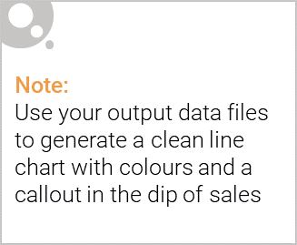
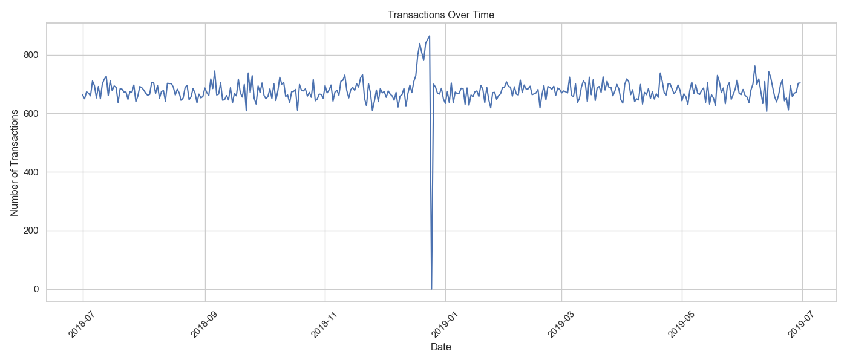
This shows transactions over time between July 2018 and July 2019, with no transactions on December 25^{th,} 2018

Slide 6
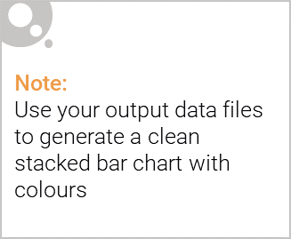
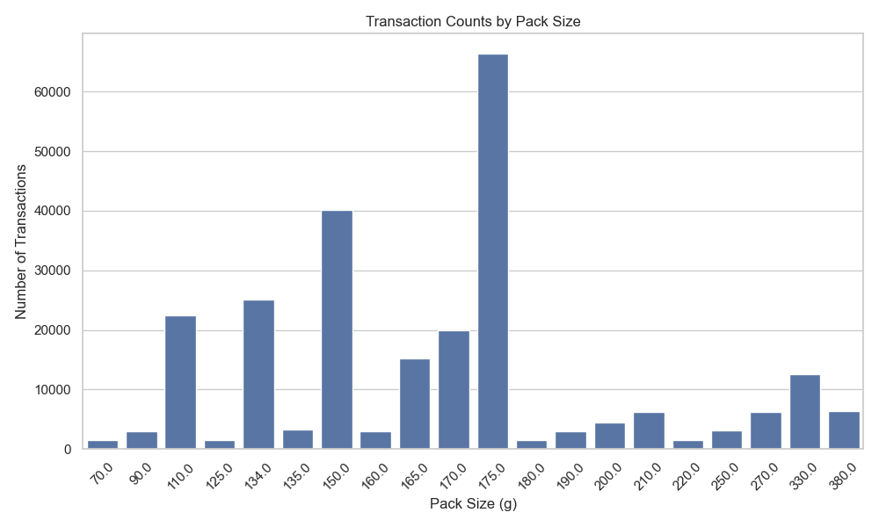
Editable (delete this)
The 175g pack size recorded the highest number of transactions, with over 60,000 units sold.

Slide 7

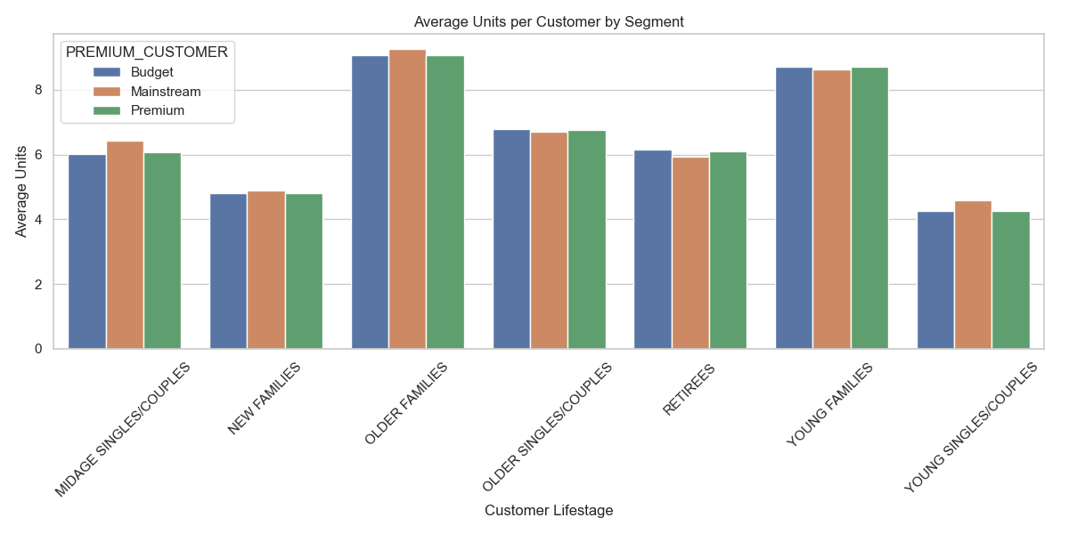
Affluence remains steady across all life stage profiles, with Older and Young Family shoppers recording the highest average units per transaction.

Slide 8
02
Trial store performance

Slide 9
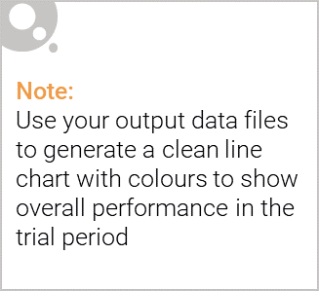
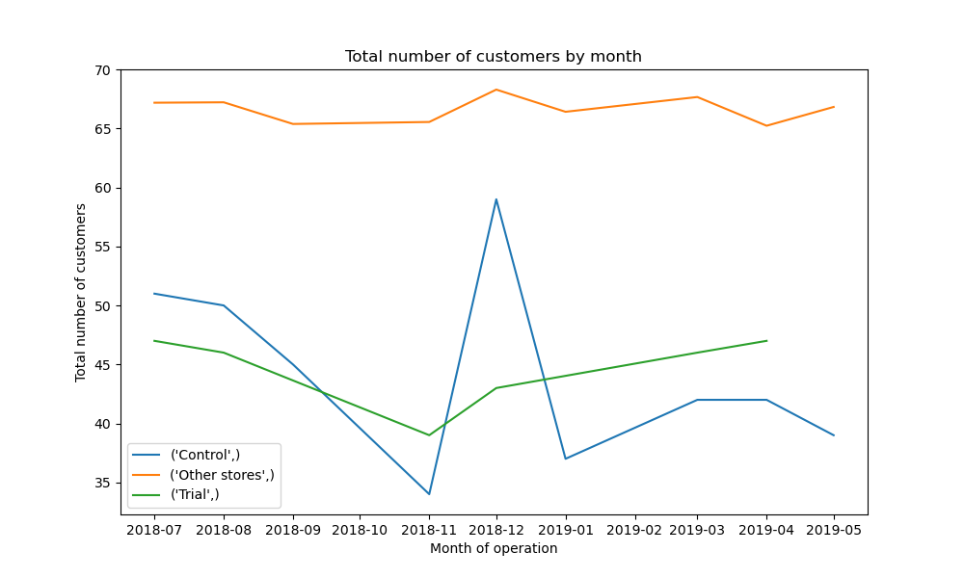
The control store is a comparable store selected to mirror the trial store’s pre-trial performance, helping measure the true impact of the trial by providing a benchmark for comparison.

Slide 10
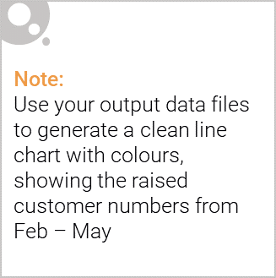
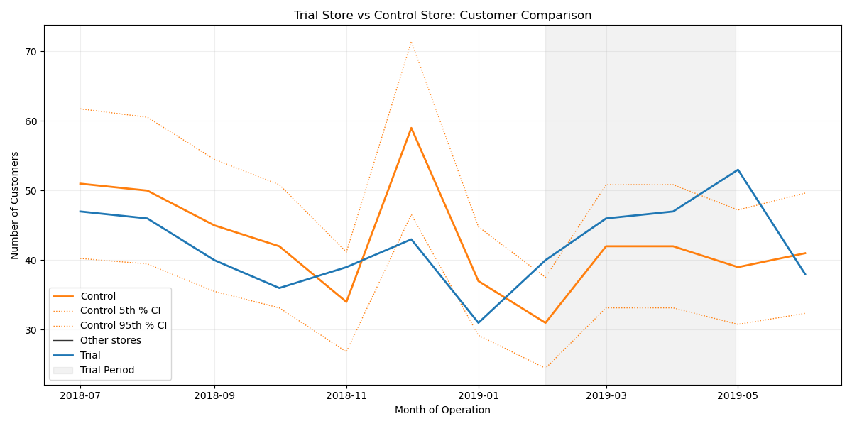
Between February and May, the trial store consistently outperformed the control store, indicating the positive impact of the new store layout.

